Slide 1
Mikroprocesorski sistemi II (connect four)
Dejan Đekanović
Duško Mirić

Slide 2
Connect four

Slide 3
Potrebni hardver
Easy 8051 ploča
RGB 8x8 matrični displej
Mreža tranzistora ULN2803 x 3
Otpornici 8 x 680R i 8 x 450R
Protoboard

Slide 4
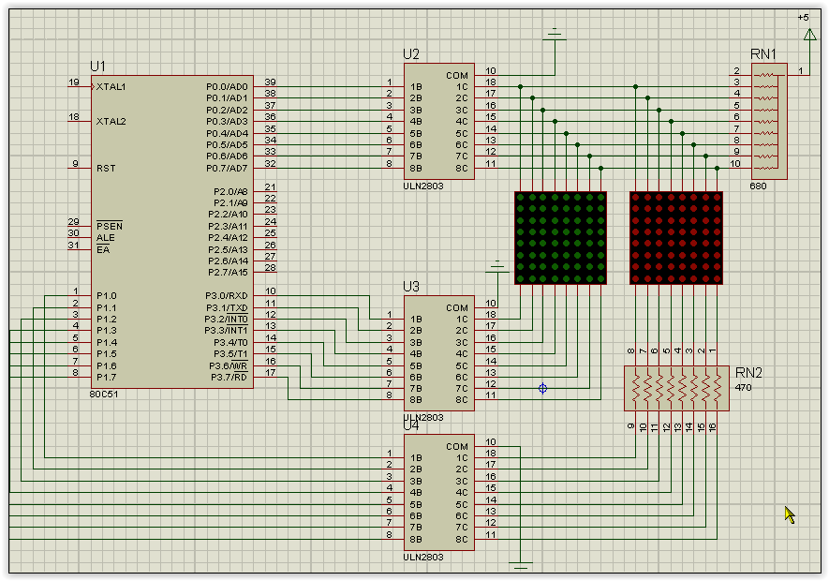

Slide 5
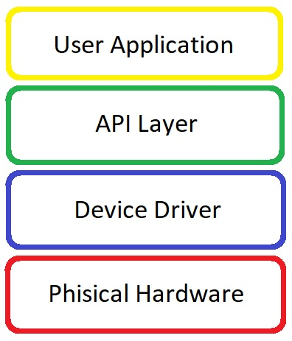
Preporučeni način organizovanja u module

Slide 6
Podjela u module
mat_driver.c – drajver za matrični displej
graphics.c – modul za apstrakciju prikaza grafičkih elemenata
keypad.c – modul za interakciju sa tastaturom
timer.c – modul za mjerenje proteklog vremena
connect_four.c – modul za apstrakciju igre

Slide 7
mat_driver.c
unsigned char mat_row[8] = {0x01, 0x02, 0x04, 0x08, 0x10, 0x20, 0x40, 0x80};
unsigned char mat_red[8] = {0x00, …, 0x00};
unsigned char mat_green[8]={0x00, …, 0x00};
void init_matrix();
void set_out(unsigned char row, unsigned char red, unsigned char green);
void refresh_matrix() iv IVT_ADDR_ET0();

Slide 8
graphics.c
enum Color {BLACK, RED, GREEN, YELLOW}
void set_pixel(short row, short col, short color);
void hline(short row, short col_1, short col_2, short color);
void vline(short col, short row_1, short row_2, short color);

Slide 9
connect_four.c
enum Disc {RED_DISC, YELLOW_DISC}
short[6][7] mat={{0, …, 0}, …, {0, …,0}};
void set_player(short color);
void insert_disc(short color);
short check_winner();
void clear_board();

Slide 10
Hvala na pažnji.

